Slide 1

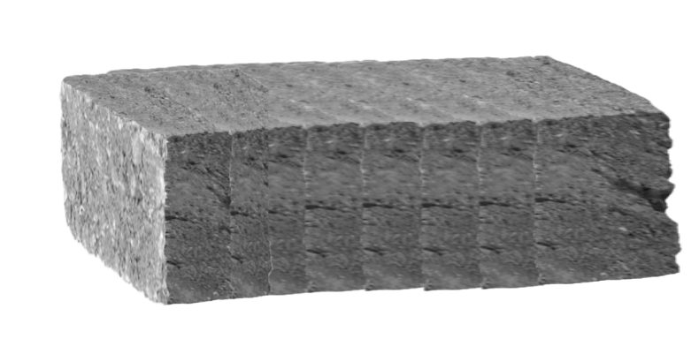
Pass The Torch

Slide 2
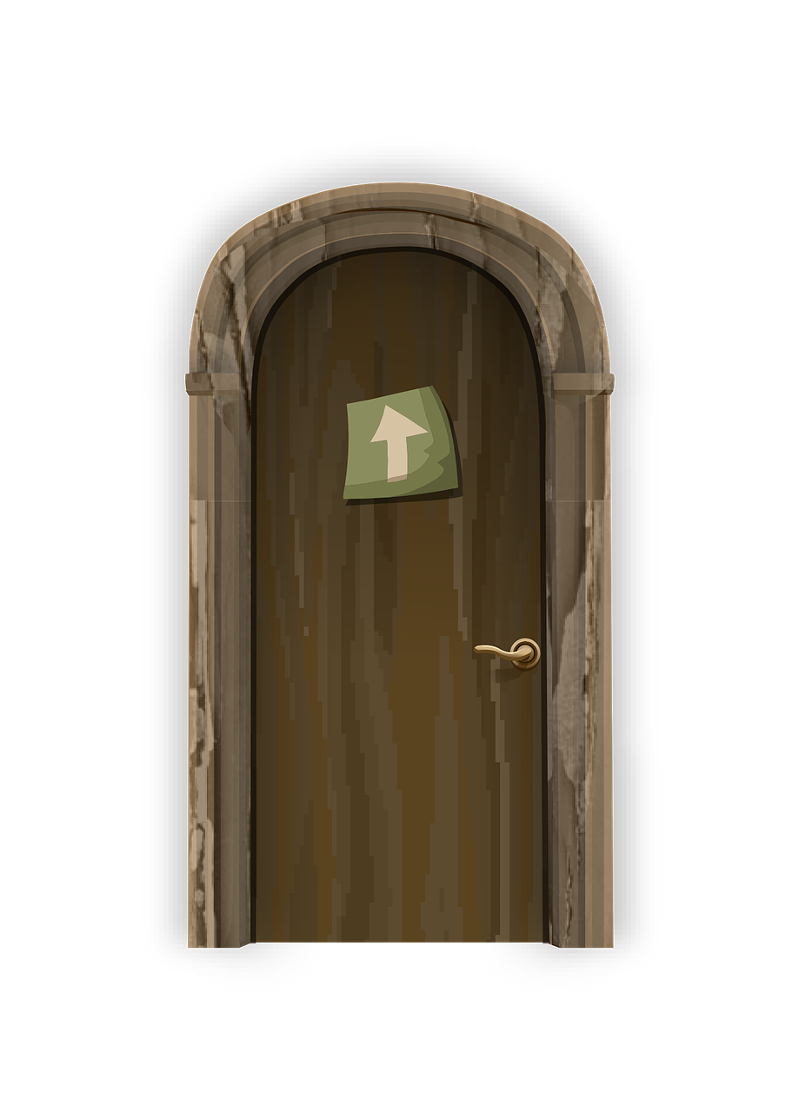
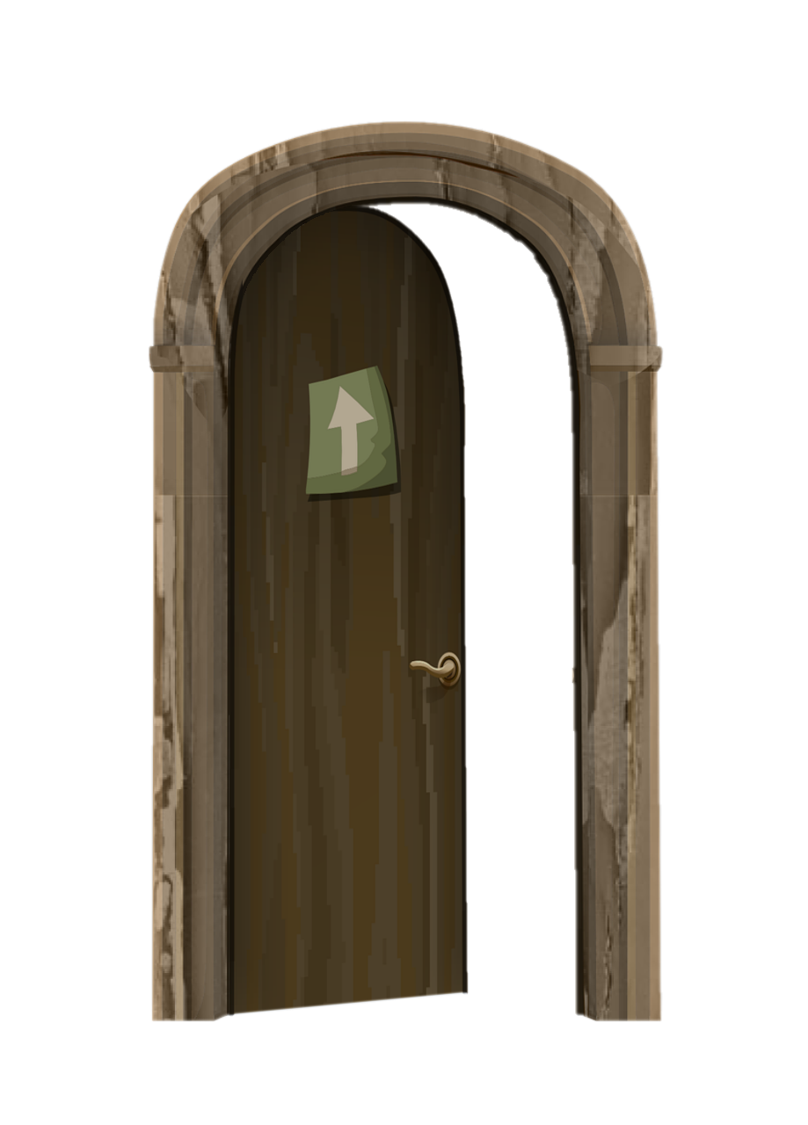

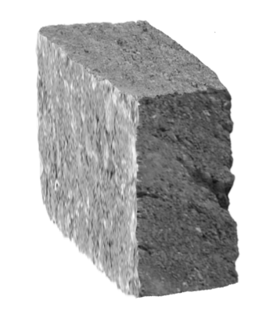






Slide 7
“Wake Up…”
My dad’s voice.
“Wake up… We need to help your grandma.”
He held a torch in his hand. I knew he’d need me.
…and I knew I’d need my son.

Slide 41


Slide 42



Slide 43
Grandma, I don’t understand.

Slide 44
“You’ve guided me home.”
“I am at peace.”
“Thanks to you my light still endures in the world.”
“It is your light now. Take it with you…”

Slide 49
The End

